Slide 1
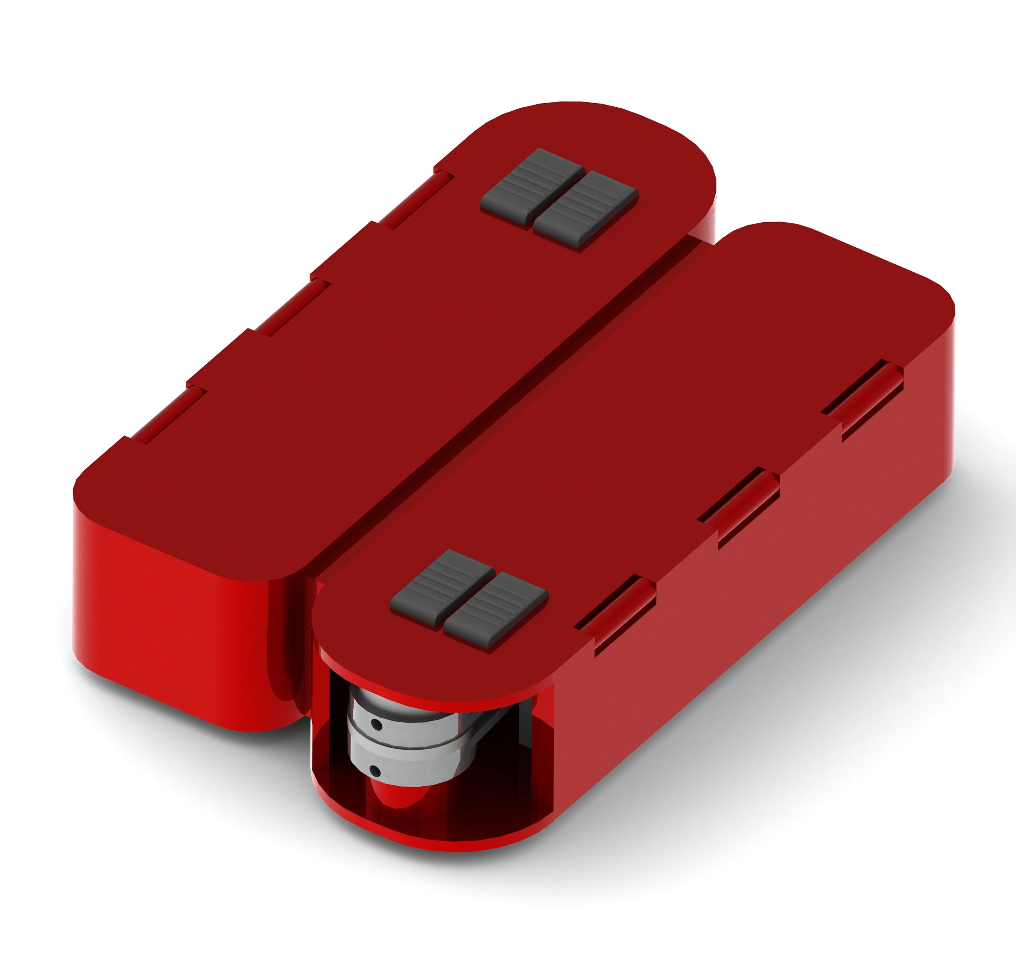
Swiss Army Knife Redesigned
Griffin Kao
Notes:
For the final project, we redesigned the traditional swiss army knife to bring it into the 21st century, focusing on the college student demographic and what tools + design principles they would consider relevant

Slide 2
Statement of Purpose
In this project, we aim to build a new kind of swiss army knife that addresses issues of sustainability. In particular, our society has grown increasingly dependent on disposable tools, like plastic eating utensils or paper cups. In fact, National Geographic estimates that approximately 100 million plastic utensils are used each day. If we can replace the need for such disposable tools with a reusable multi-tool that is equally as functional, we can reduce the amount of waste generated from their disposal.
With this focus in mind, we’ve chosen college students as our target audience, perhaps the greatest perpetrator of wasteful consumption. Note that our target audience generally finds themselves less in need of tools central to the original army knife (like knives and pliers) and more in need of implements necessary for the modern existence (like eating and drinking utensils). Further yet, the aesthetic characteristics of the swiss army knife are outdated and must be brought into the twenty-first century to compel members of generation Z to usage. Thus, we’ve derived two major design tenets from these values: (1) more relevant tools in that the tools we develop are useful to the target audience and (2) aesthetic/modern design to push widespread acceptance in this new age.

Slide 3
Constraints
Note that these are with the target audience of college students in mind
Fits in pocket / easy to transport (protect eating surfaces)
Aesthetically pleasing
Relatively easy to manufacture: not too many parts
Easy to understand how to use
Cheap

Slide 4
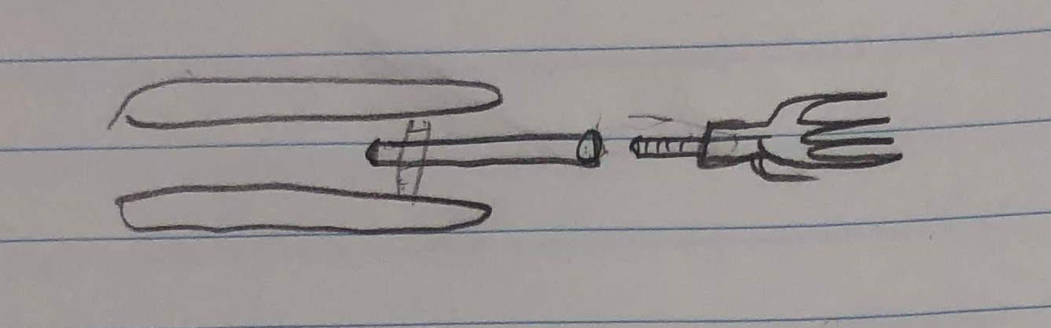
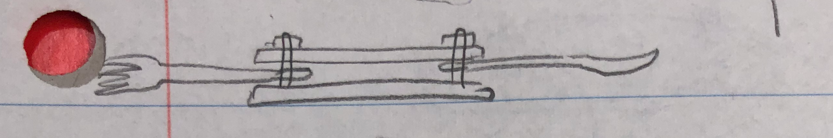
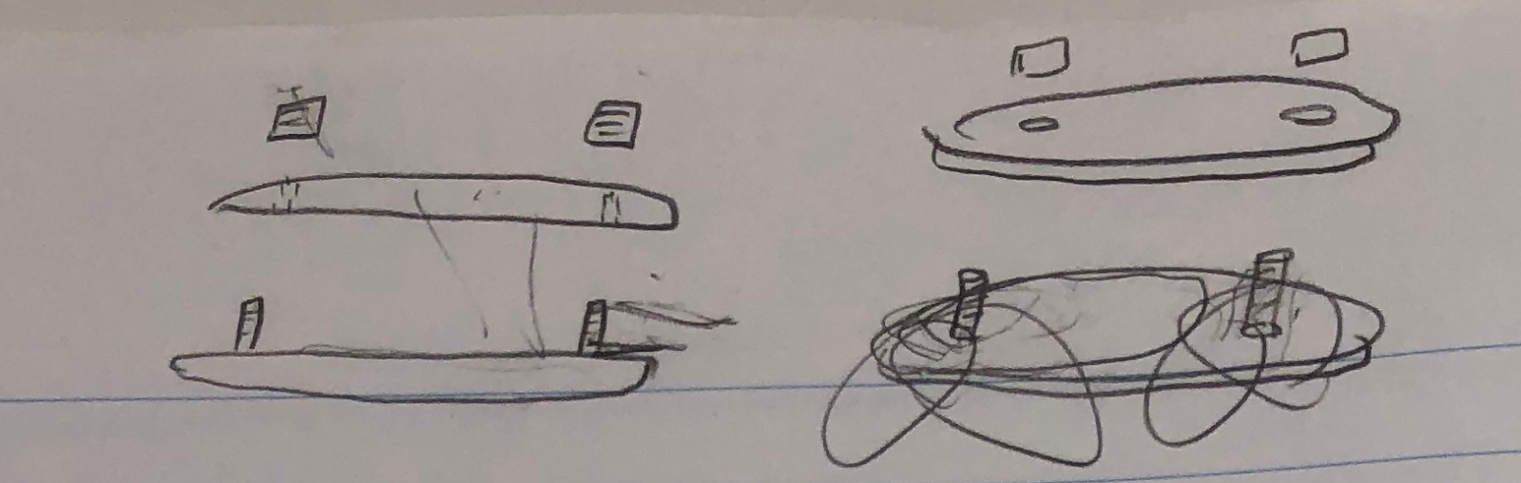
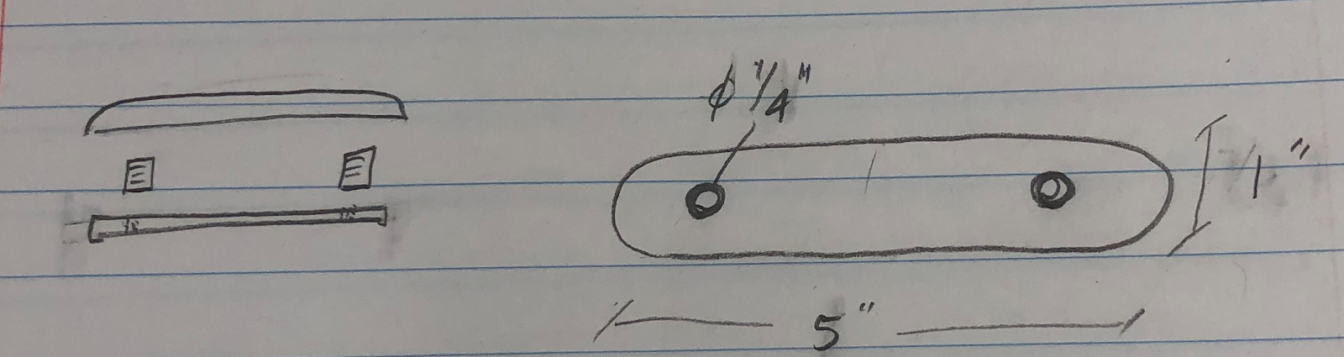
Design Iteration 1
With modularity in mind, we first had this screw-off design where we could remove the screws at the top of the casing to be able to slide various tools off.
Pros: Easy and close to original SAK design
Cons: Can’t use multiple utensils at once, complexity of multiple parts for the user

Slide 5
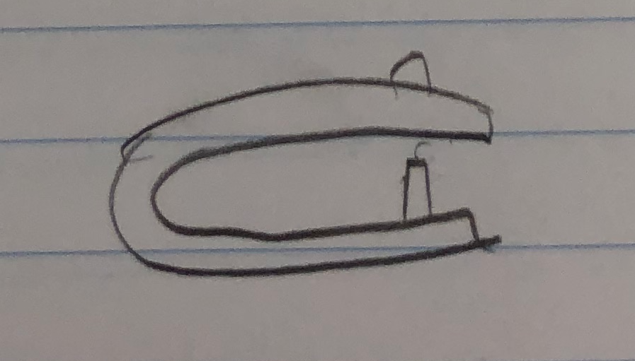
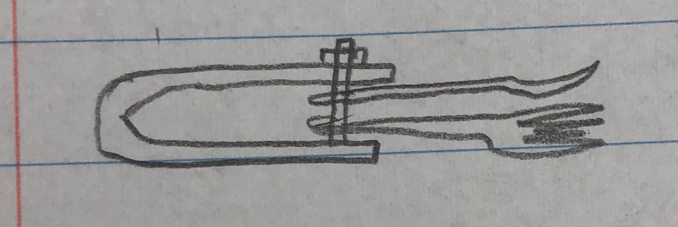
Design Iteration 2
Compliant mechanism on one side
Pros: Simple and easy for the user to switch out tools
Cons: Possibly difficult to manufacture a compliant mechanism, can’t use multiple utensils at once

Slide 6
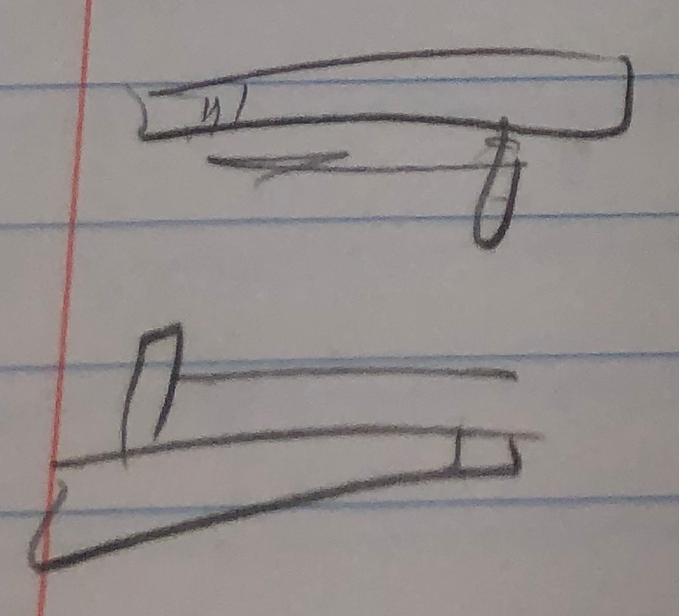
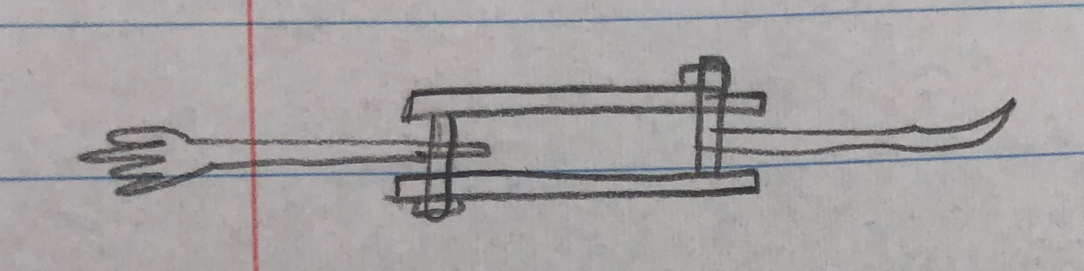
Design Iteration 3
Separate casing - we chose this design because we ultimately determined that modularity is less important than convenience for our target audience
Pros: Can use multiple utensils, overall easy to use/figure out
Cons: Multiple parts adds some complexity

Slide 7
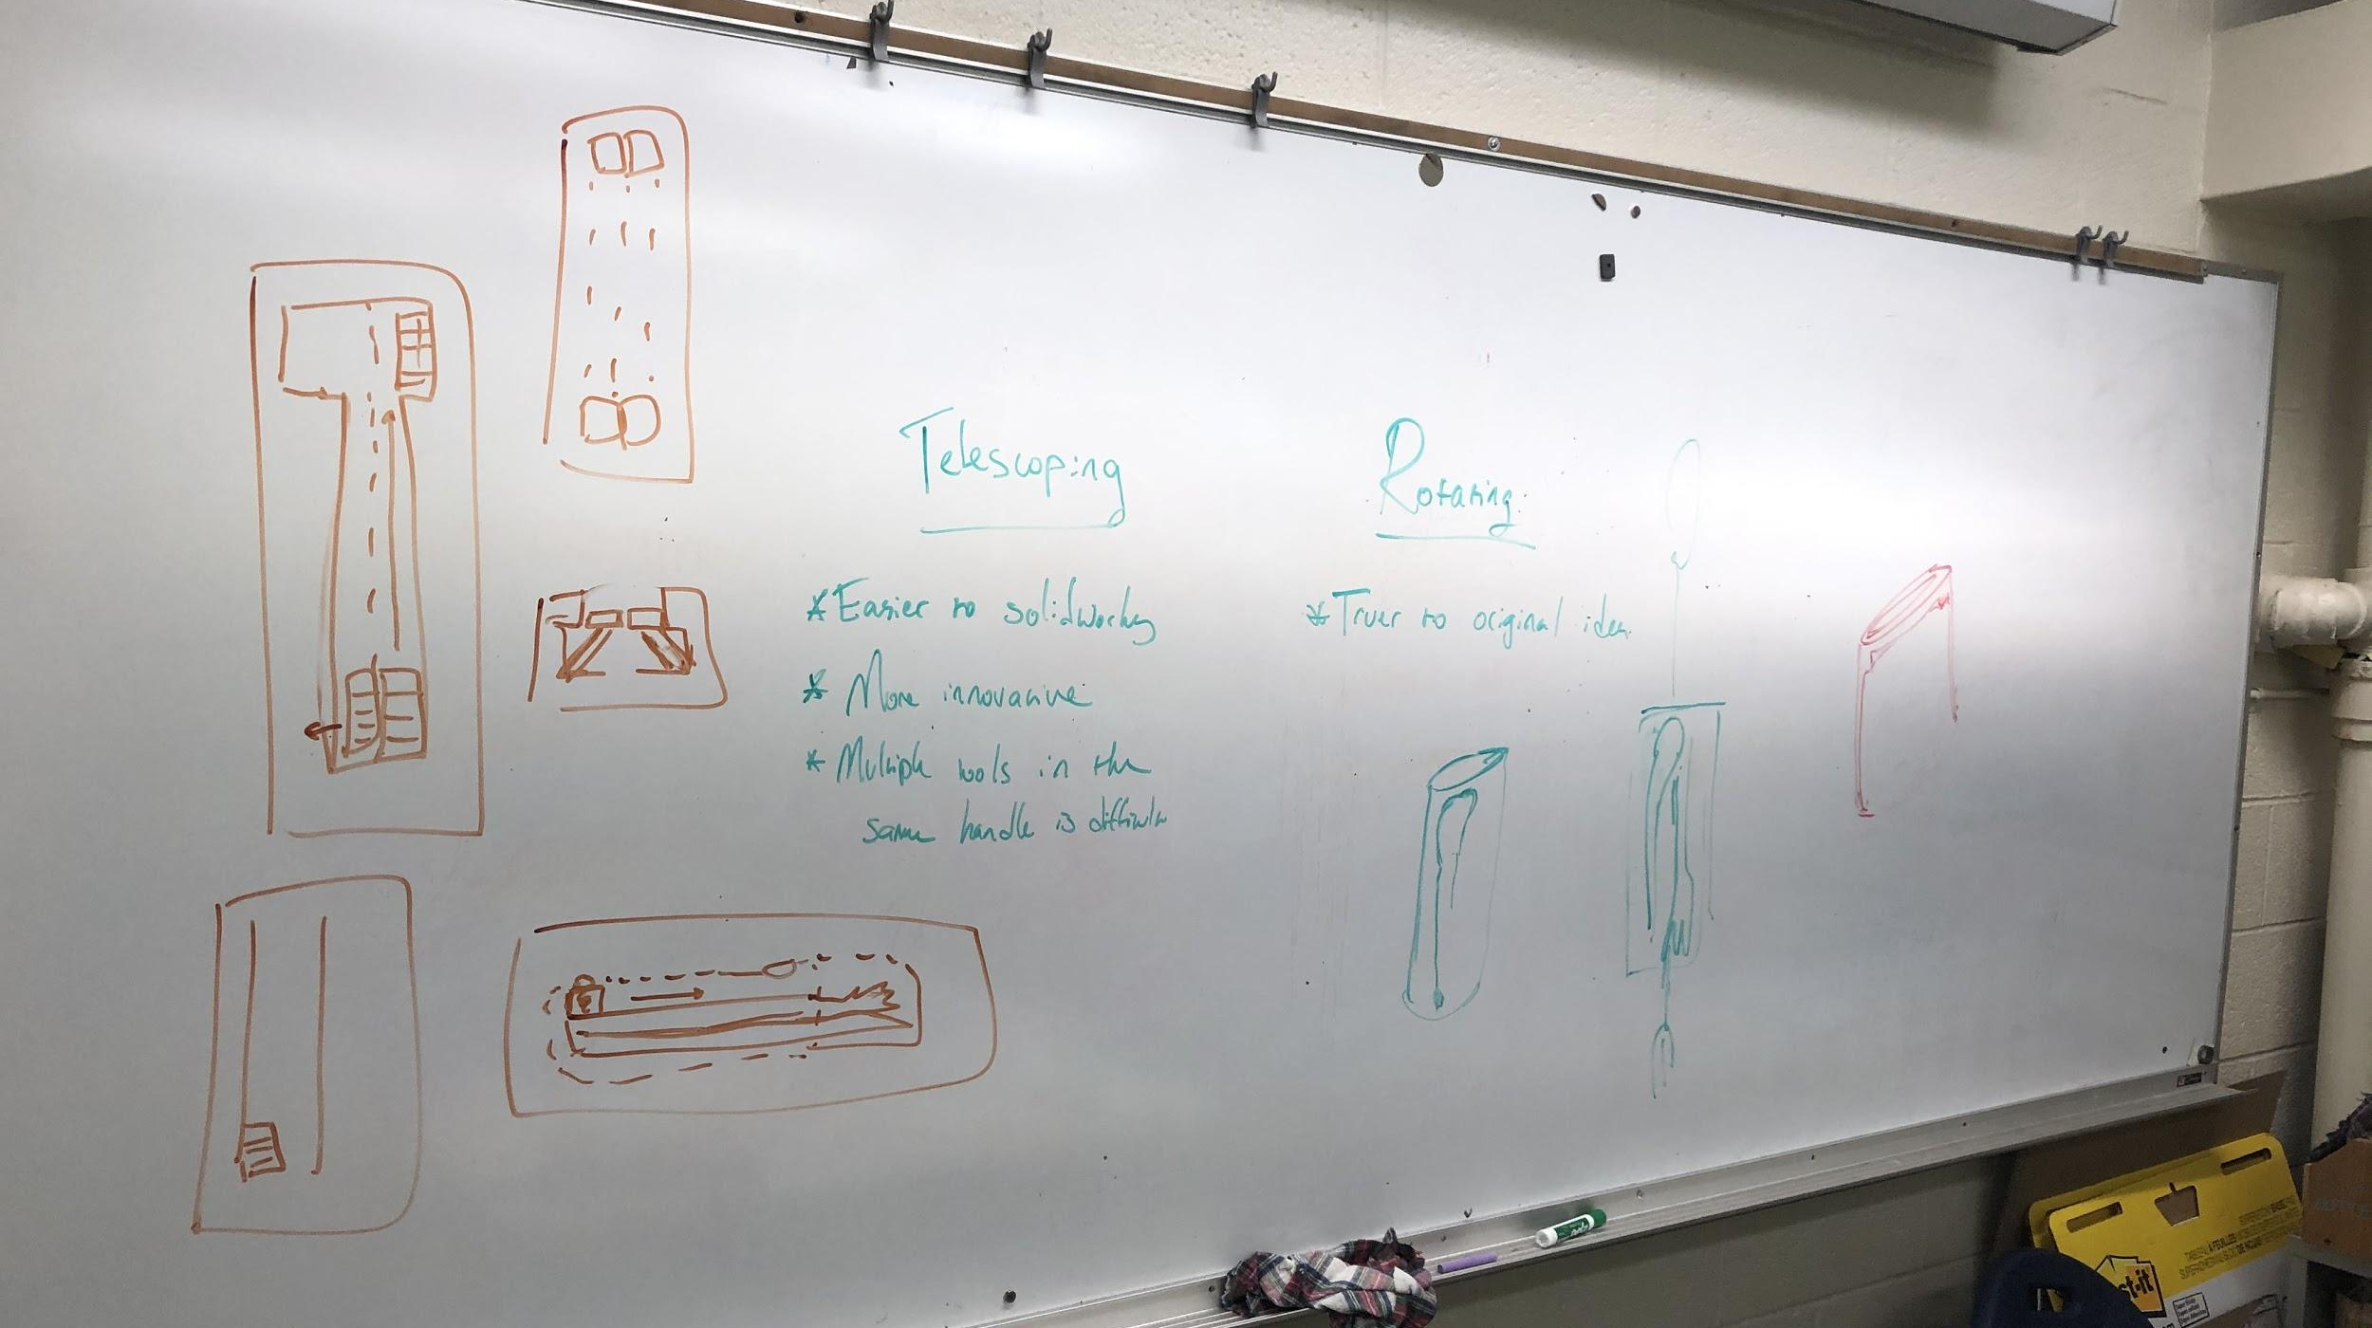
Refining Design
Once we had our high level design nailed down, we iterated on the specifics - choosing between a rotating flip out mechanism and a slide out mechanism to release the utensils. We ultimately chose a rotating design for ease of design
and because it seemed more intuitive to use. For the utensils, we chose to include a fork, a spoon, a knife, and a bottle opener given that these are the most commonly used. Since knives and forks are most often used together, we put those in different subassemblies. To accommodate the locking mechanisms, we put each flat utensil with either the fork or spoon - thus pairing the spoon and knife, and the bottle opener and fork.

Slide 8
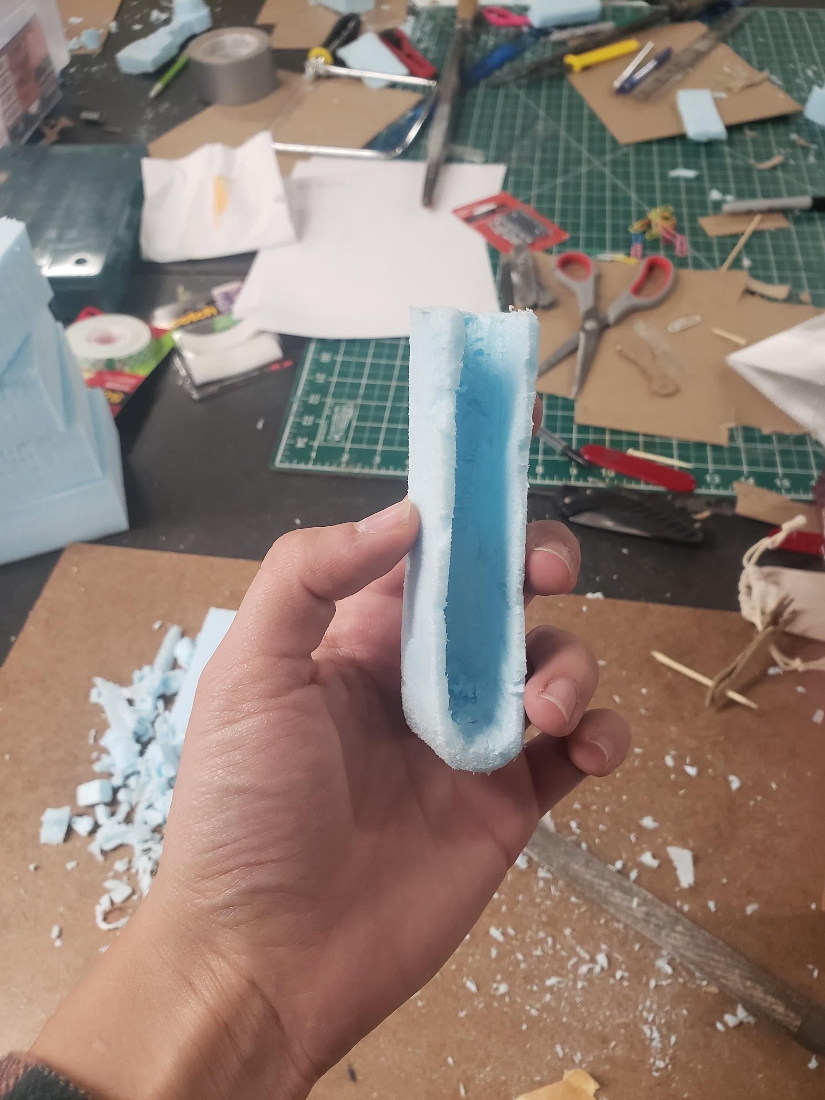
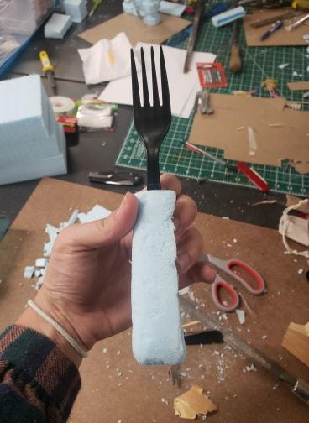
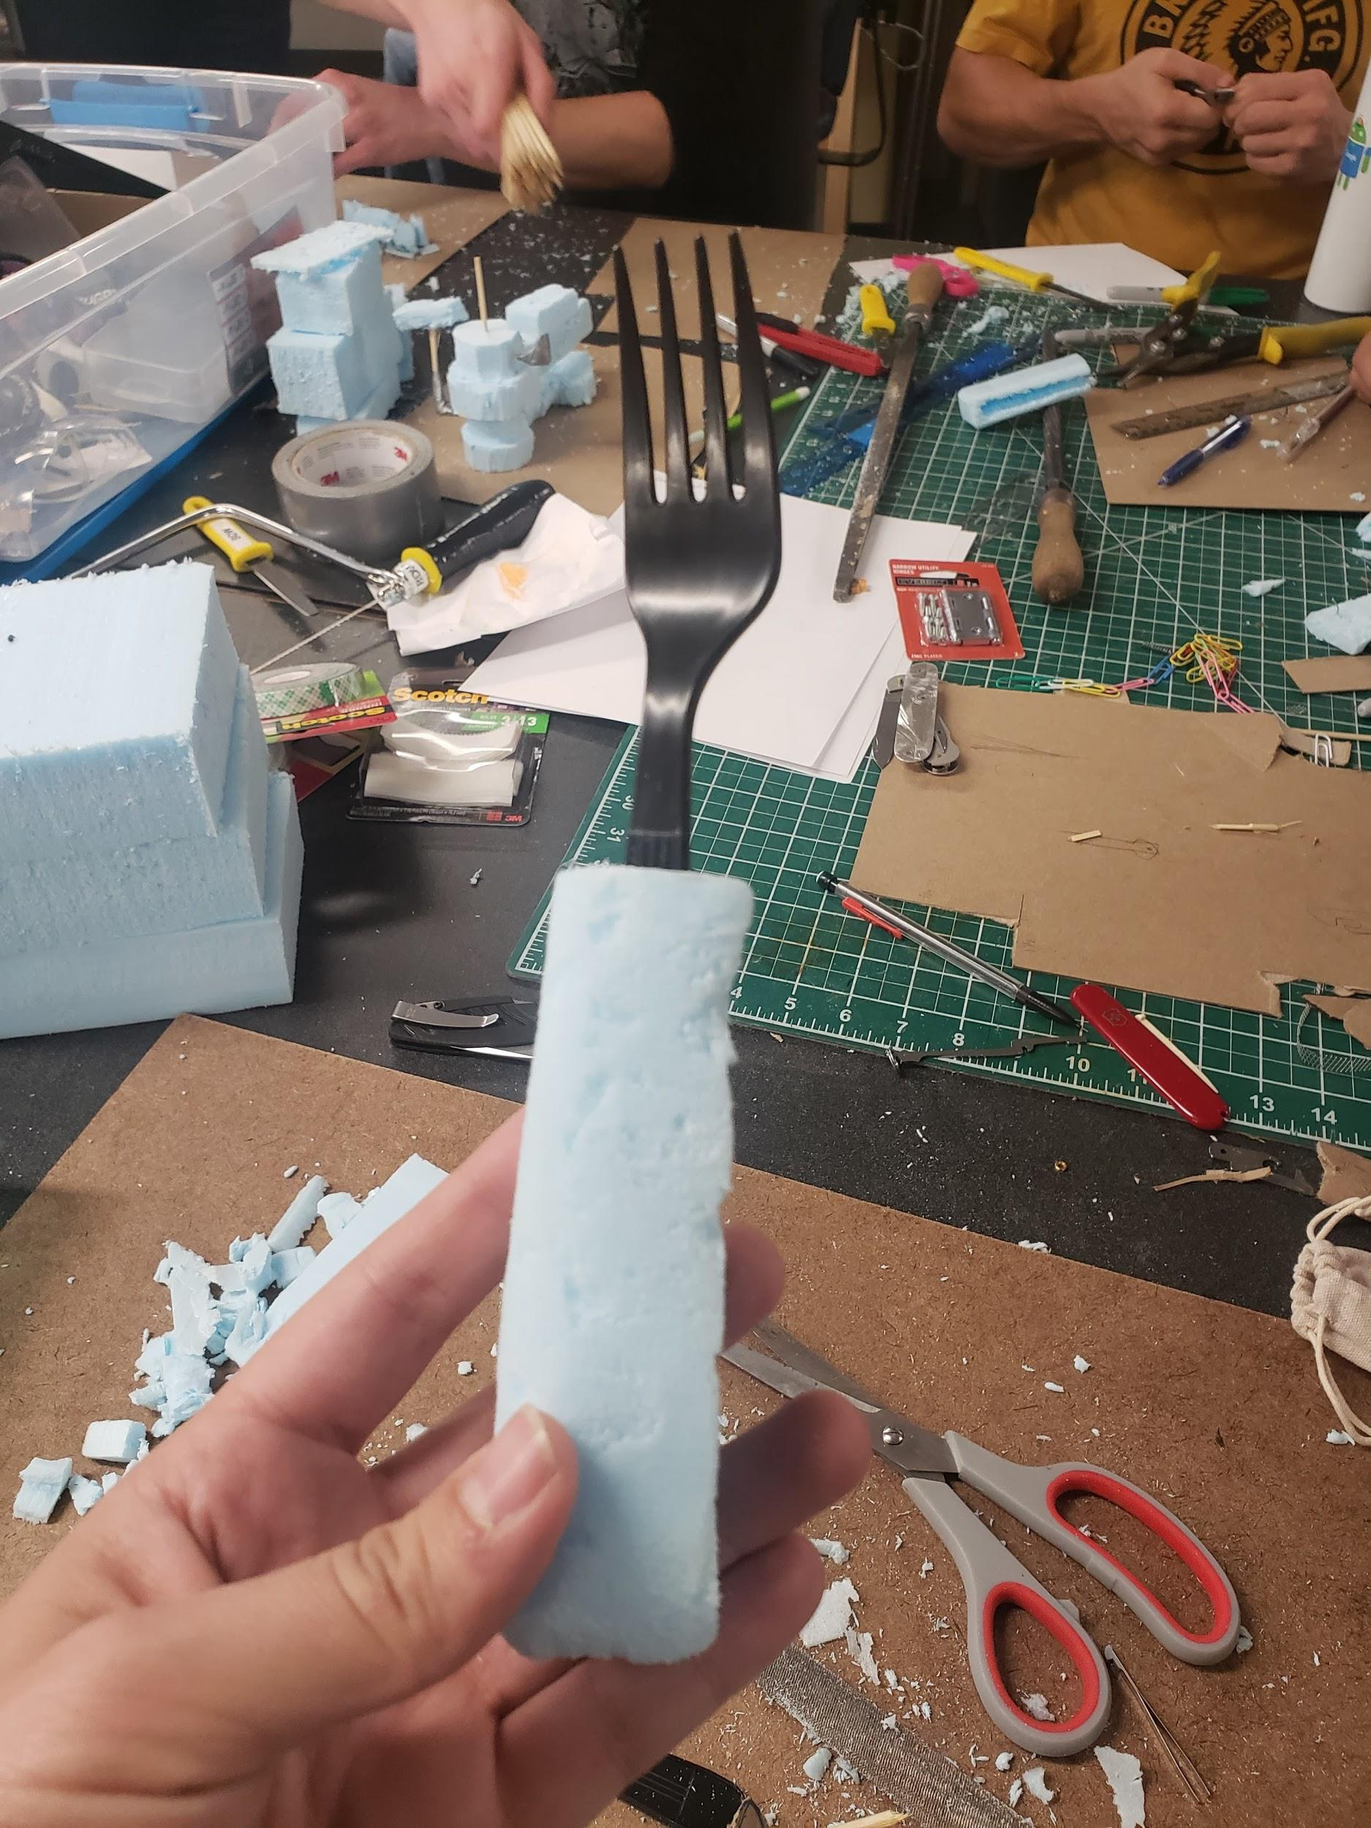
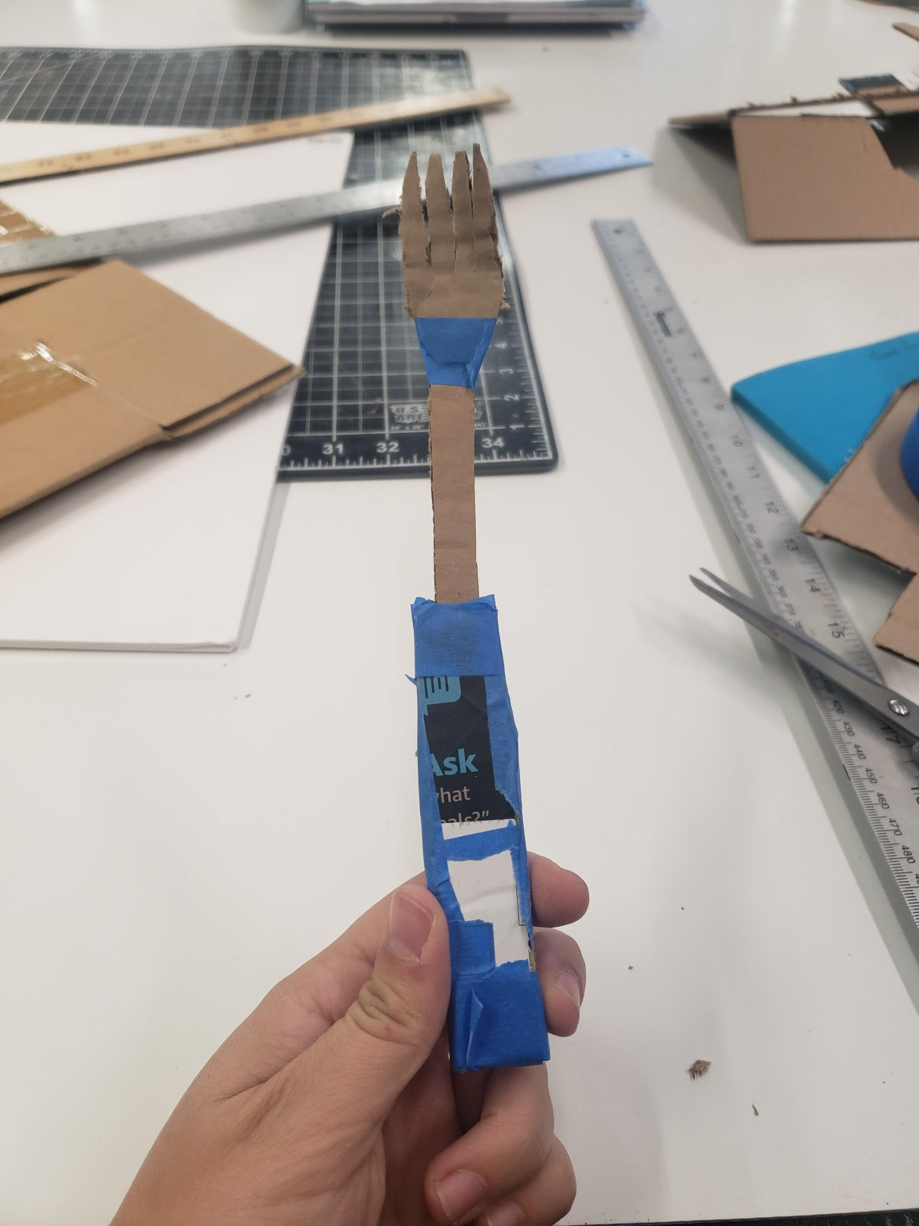
Physical Prototyping
Sizing was a big concern as we wanted our design to be comfortable in the hand while our utensils were being used.
We built prototypes of both the switch blade and the retractable blade ideas.

Slide 9
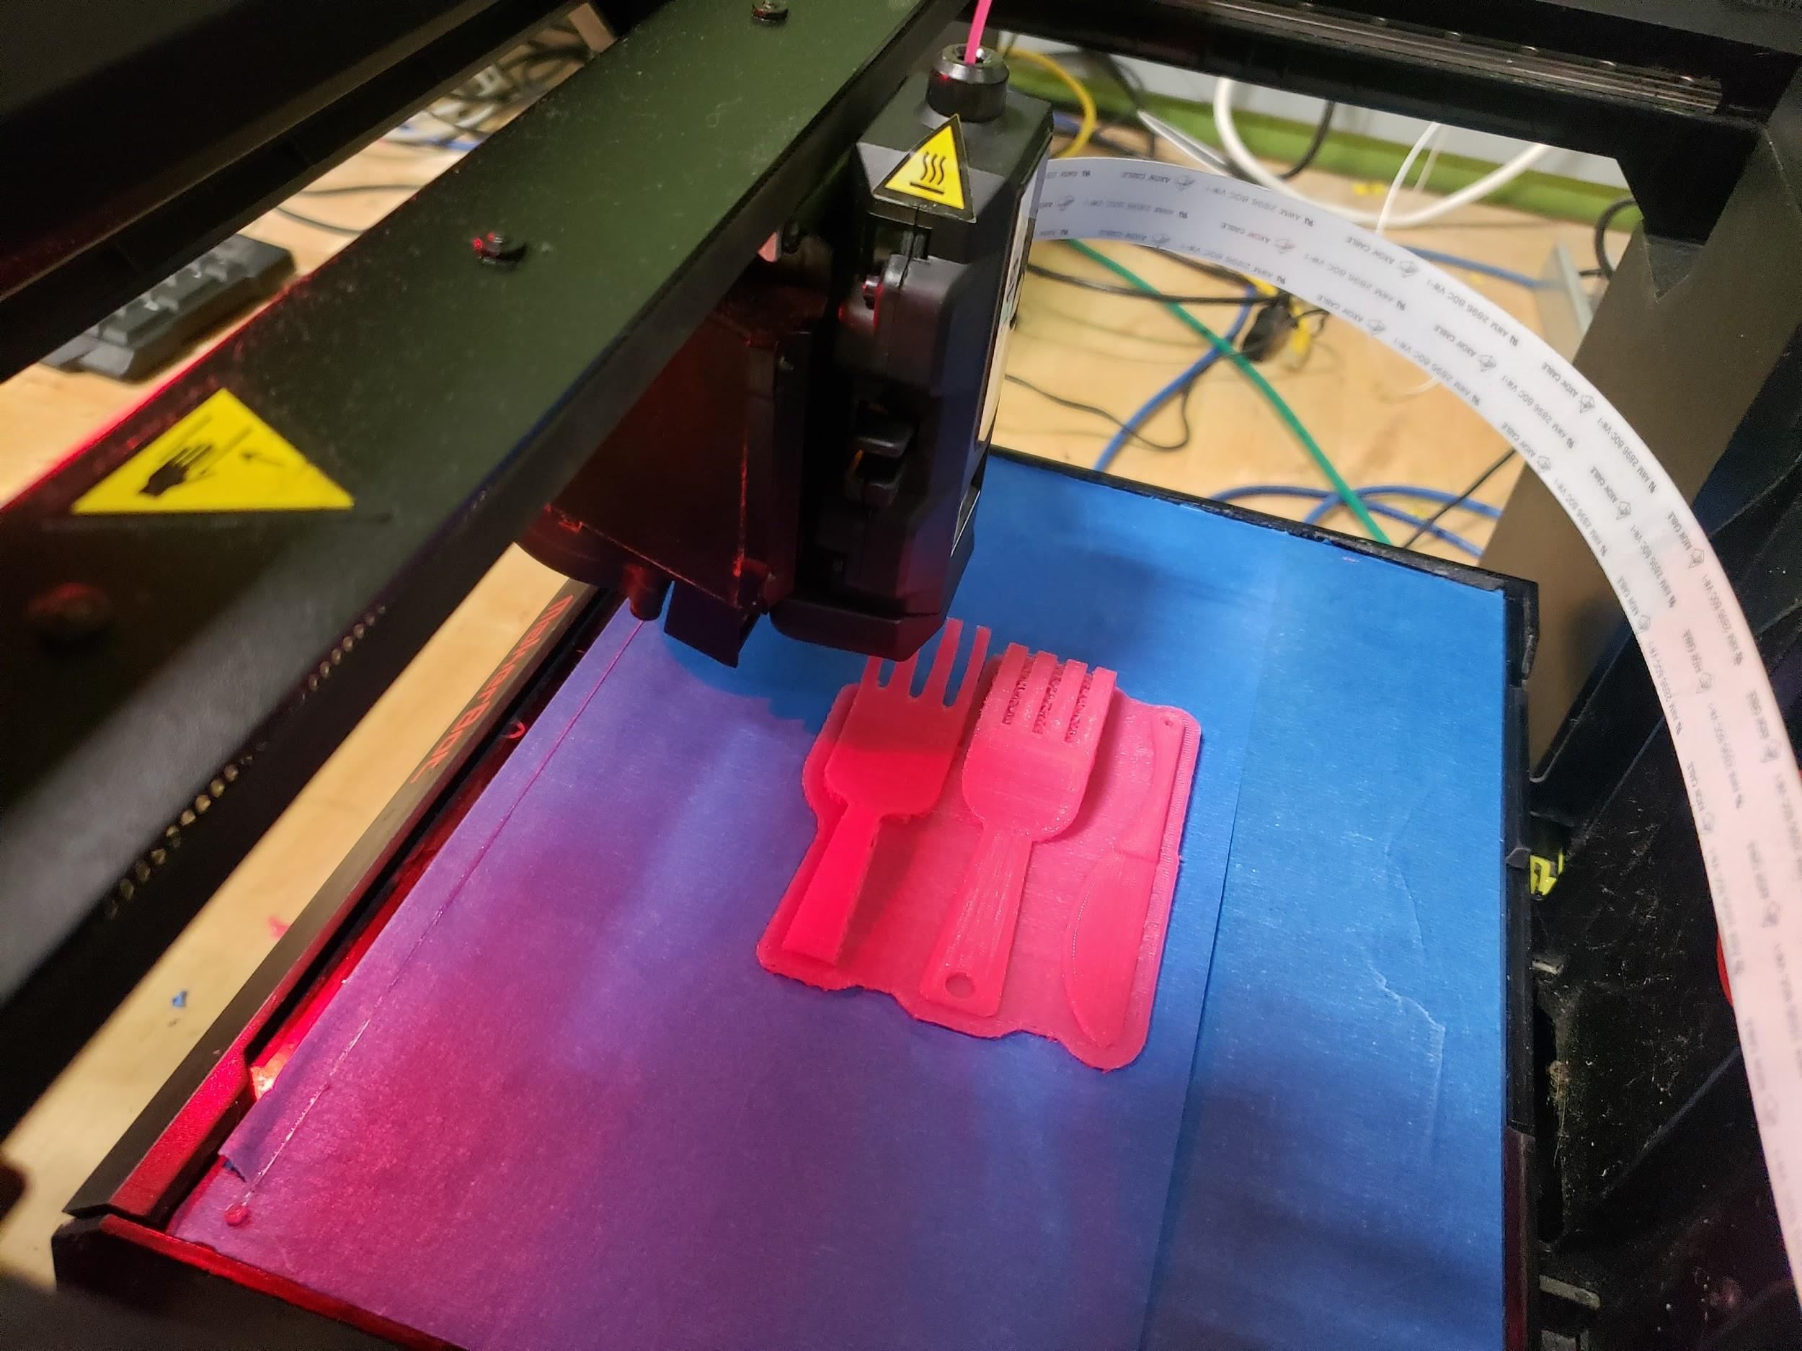
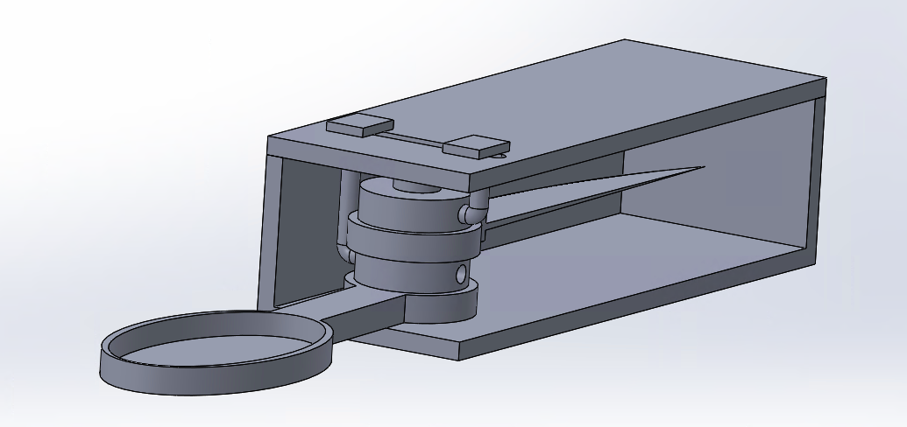
Prototyping cont.
A simple SolidWorks model was made to visualize where we were going with our design
This helped us pinpoint issues that led to the addition of a door and an adjusted shaft for the switch blade mechanism
3D prints of the fork and spoon were made to ensure that they were the correct size for the user's needs

Slide 10
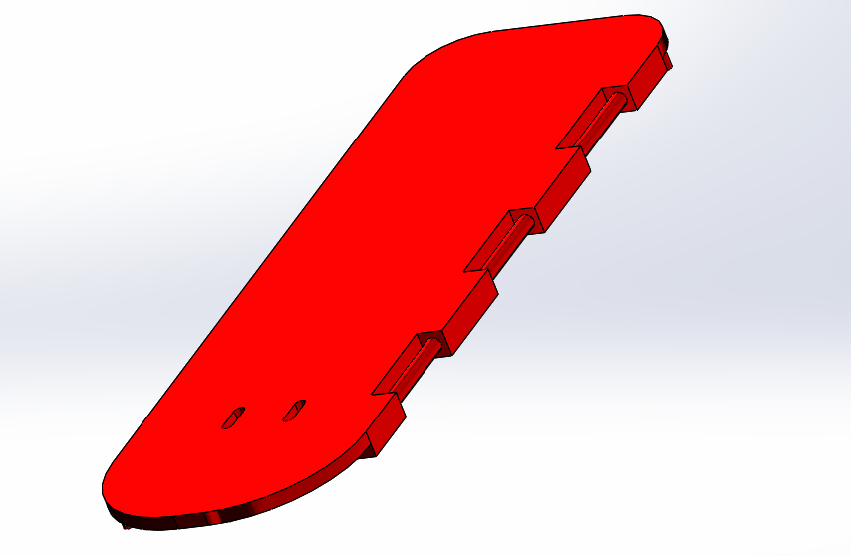
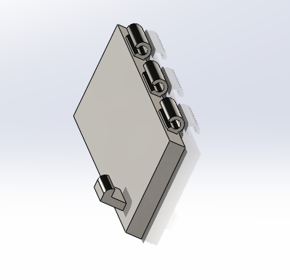
Door + Hinge
Used a simple flush hinge design (case top on left, door on right). Door has component that notches into the locking mechanism that closes the assembly.

Slide 11
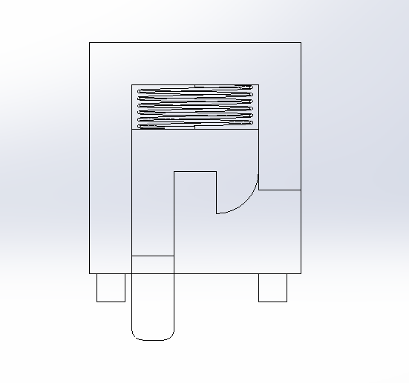
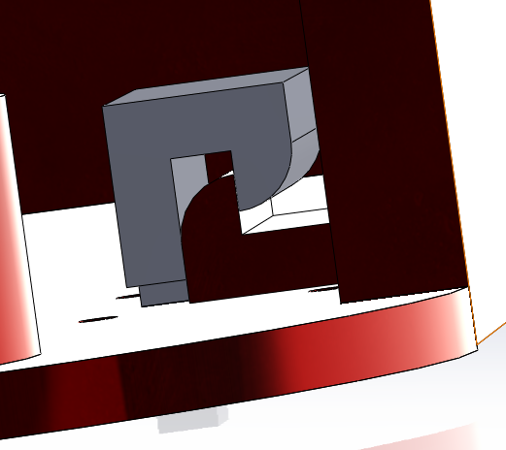
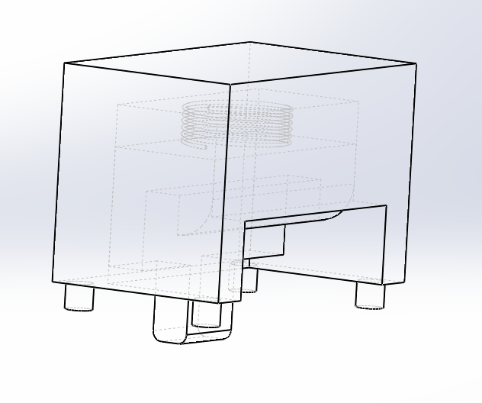
Door Locking Mechanism
Push tab on the bottom of the casing to release. (Lock case
suppressed in left image.)

Slide 12
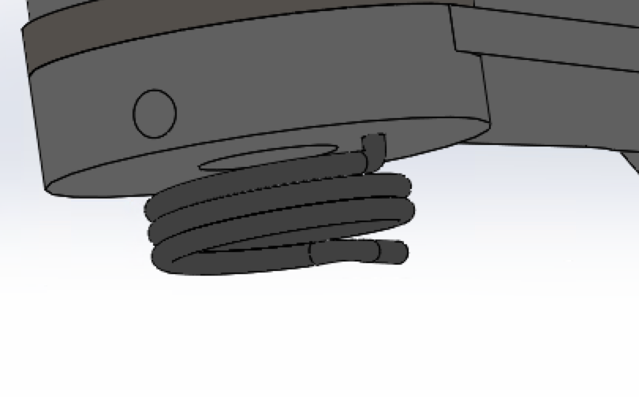
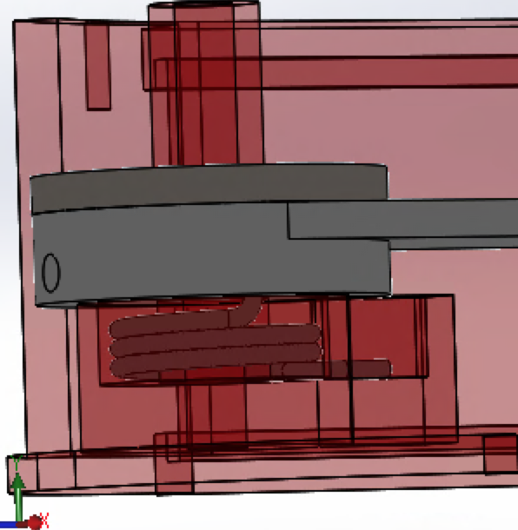
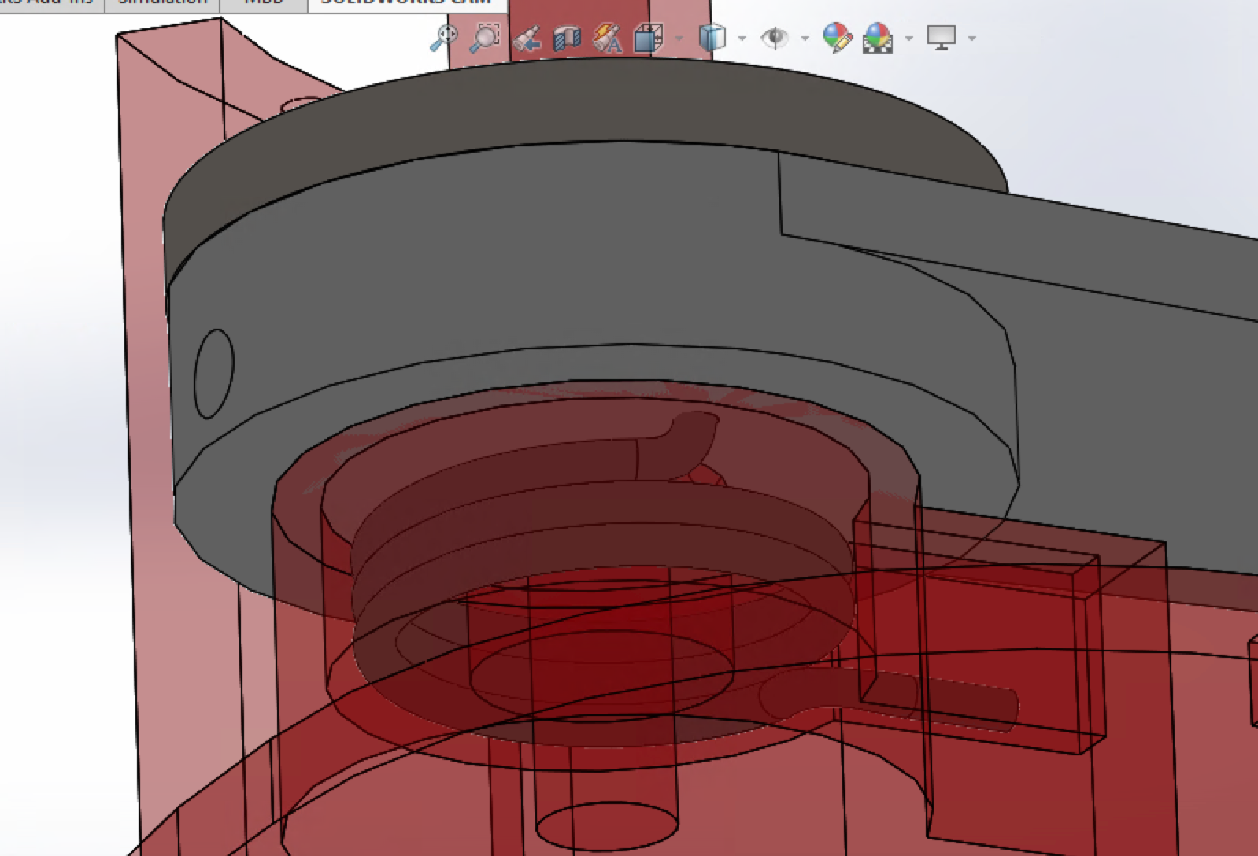
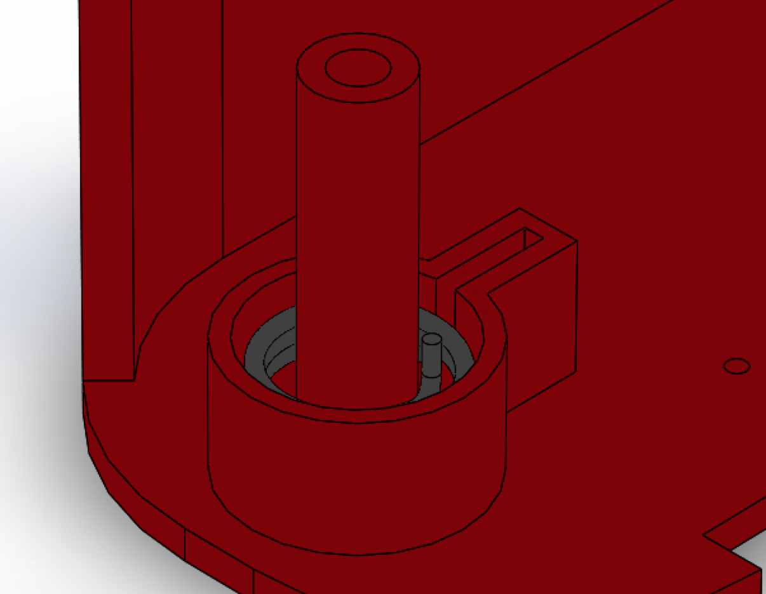
Spring Assisted Utensil Rotation
One torsional spring is attached to each utensil so that when the locking mechanism is released the utensil swings out
The design was inspired by switchblade knifes

Slide 13
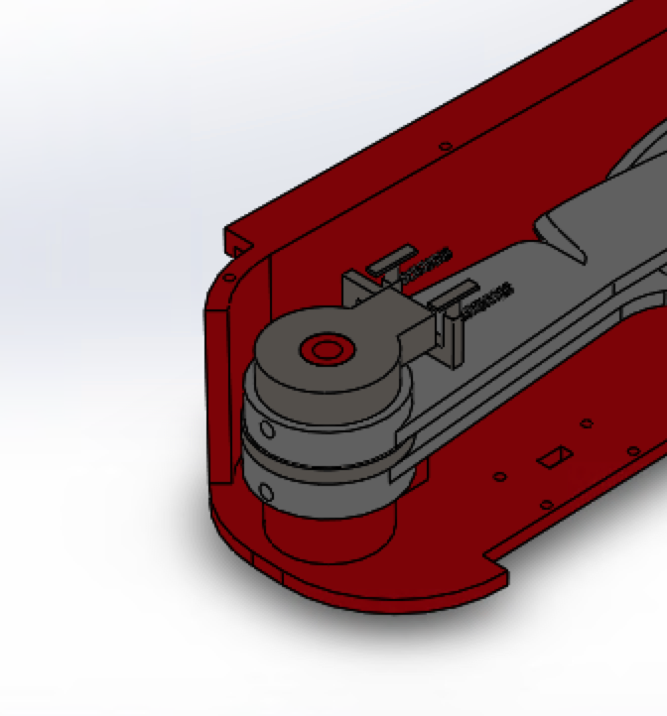
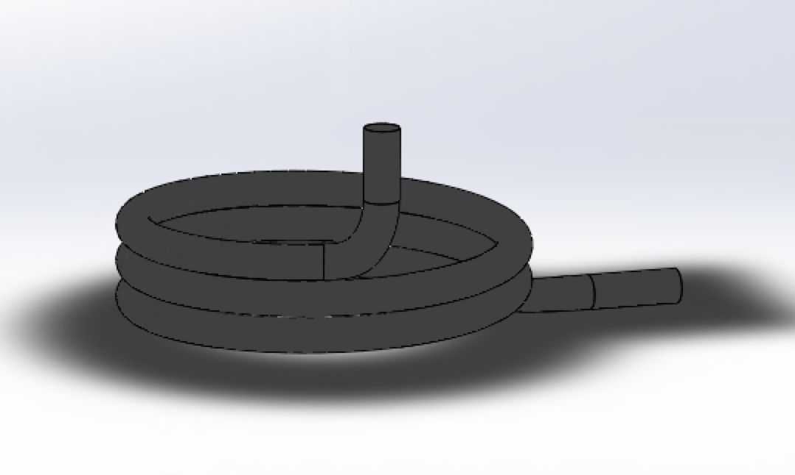
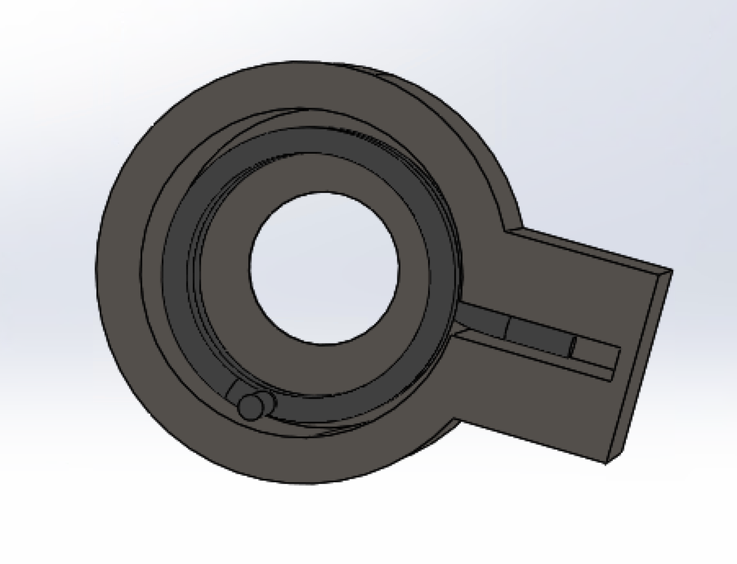
Overall Rotation Mechanism
A Light Duty Dry-Running Thrust Bearing (McMaster Carr) was placed in between the two rotating utensils.
The top rotation piece holds the second torsional spring for the top utensil in the assembly.
The torsional springs are custom made

Slide 14
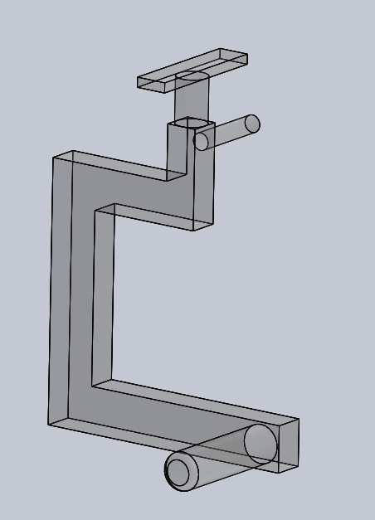
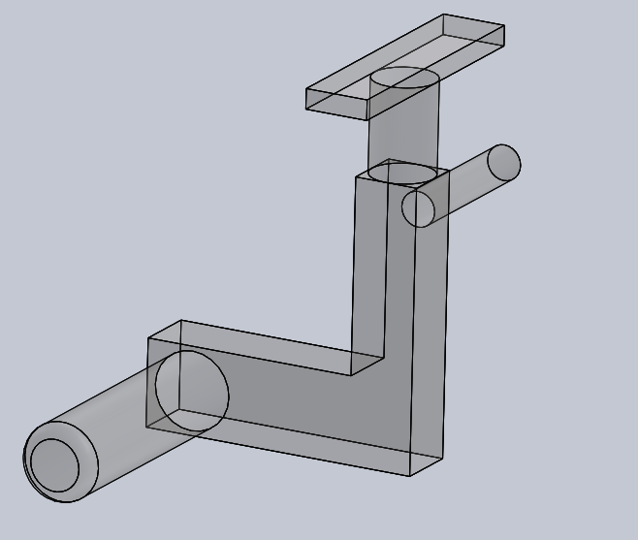
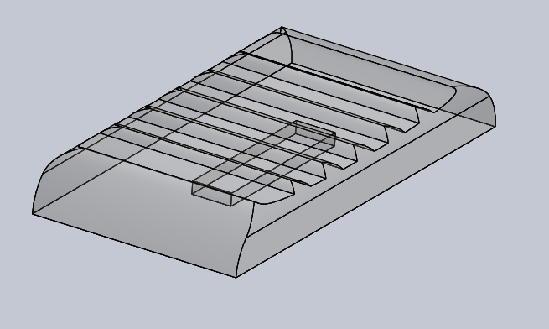
Utensil Lock/Release Mechanism
(left to right) Utensil Release Tab, Lower Utensil Lock, Upper Utensil Lock

Slide 15
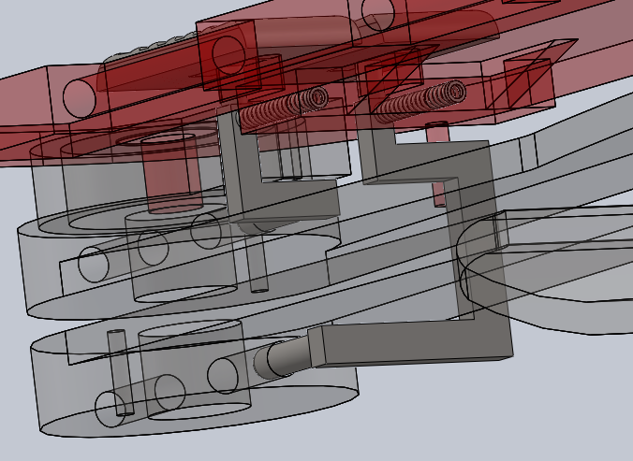
Utensil Lock/Release Mechanism Subassembly
The utensil lock/release linkages are strategically designed and located to avoid collision with the path of a releasing utensil. Helical compression springs connect the linkage to the case top. Cantilevers lock the utensil in the retracted/released position. Tabs must be separate parts for manufacturability.

Slide 16
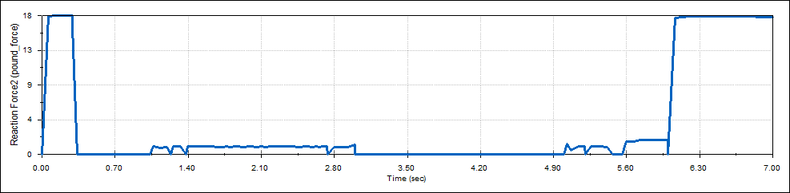
Motion Analysis
Four motion studies were performed for the Swiss Army Knife using Solidworks to test its basic operations. The studies observed the case door opening and closing, the upper and lower utensils releasing and retracting (knife and spoon), and the two separate assembly cases separating and attaching. Only parts and mates relevant to these individual operations were considered - all others were suppressed for calculation efficiency.
Of the two utensils tested, the spoon required greater torque to operate (5.3 lbf-in vs. 3.5 lbf-in) and experienced greater contact force with the utensil lock cantilever (18 lbf vs. 12 lbf max). Thus, geometry and mass of the utensil is a necessary consideration when determining spring constants and operational forces.
Spoon/Utensil Lock Contact Force
From retracted -> released -> retracted

Slide 17
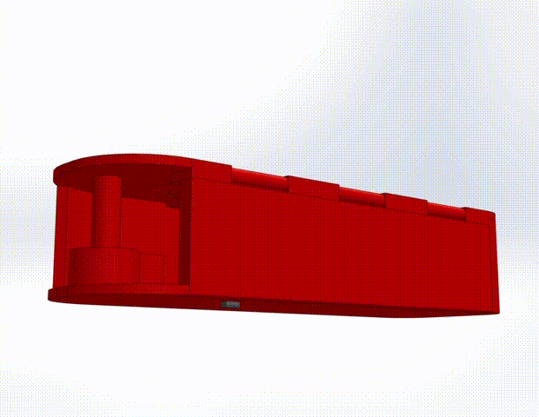
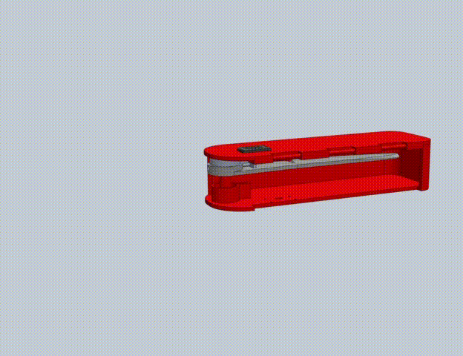
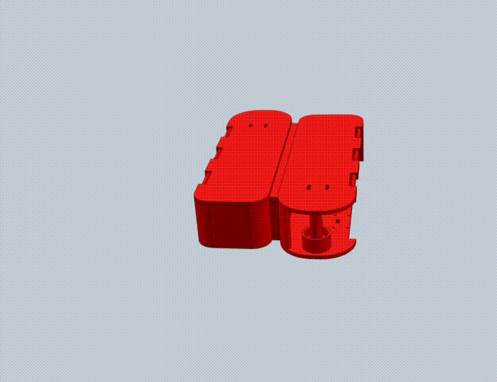
Animations
Animations were generated from the motion analysis studies. Unnecessary parts/mates were suppressed as seen in the animations above (left to right: case door opening/closing, knife releasing/retracting, case separation/attachment).

Slide 18
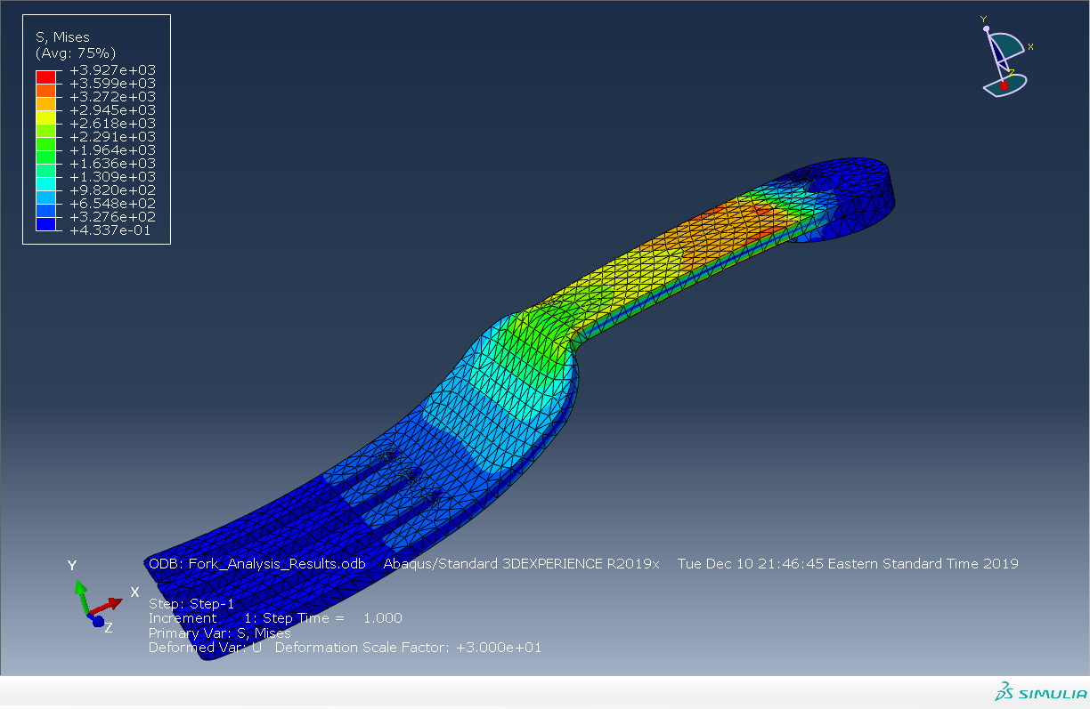
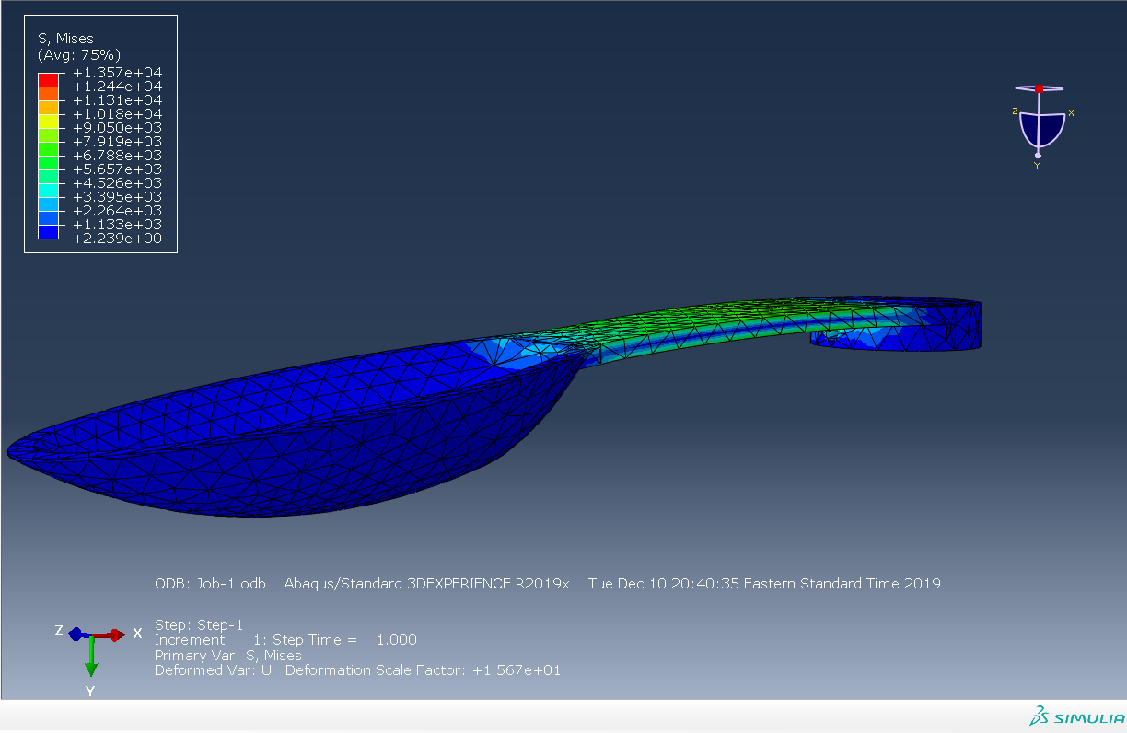
Finite Element Analysis
Using Abaqus, we analyzed eating-related stresses on the utensils and the force of the torsional springs on the release tabs. All the analyzed components are composed of steel, so we assumed a Young’s Modulus E = 29E6 psi and a Poisson ratio = 0.29.
Relative to the other utensils, the fork and spoon experienced lower stresses. Max stress on the fork is 3.927E3 psi while max stress on the spoon is 7.919E3 psi.

Slide 19
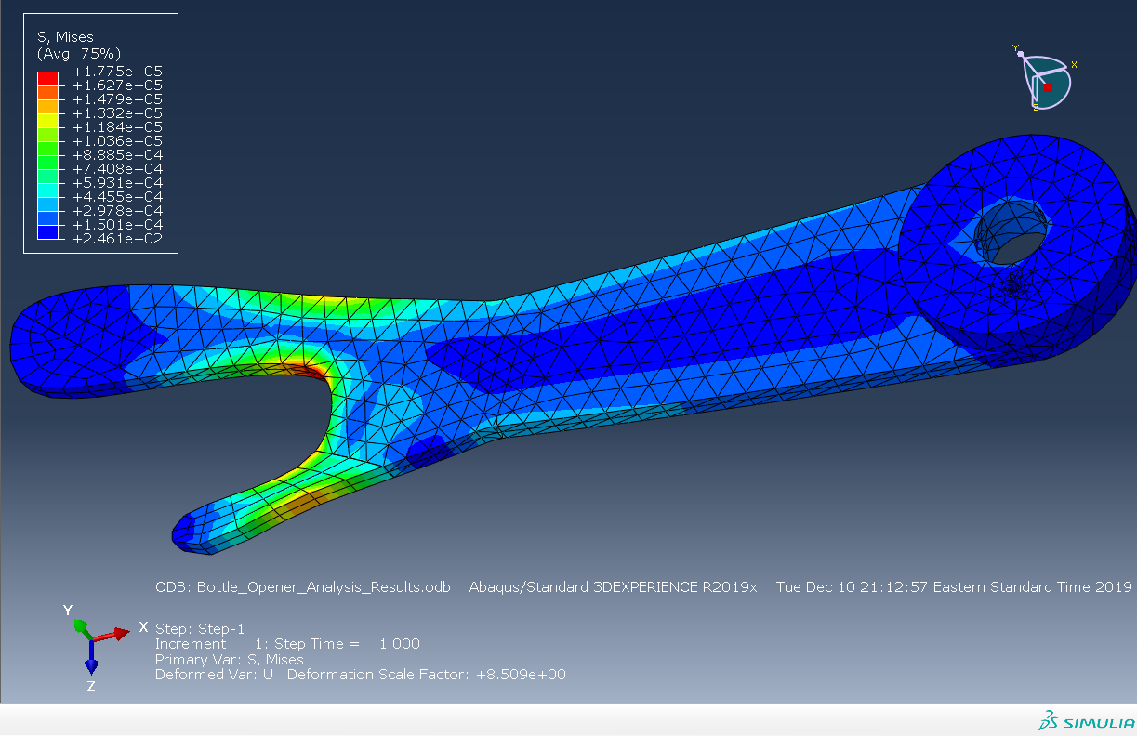
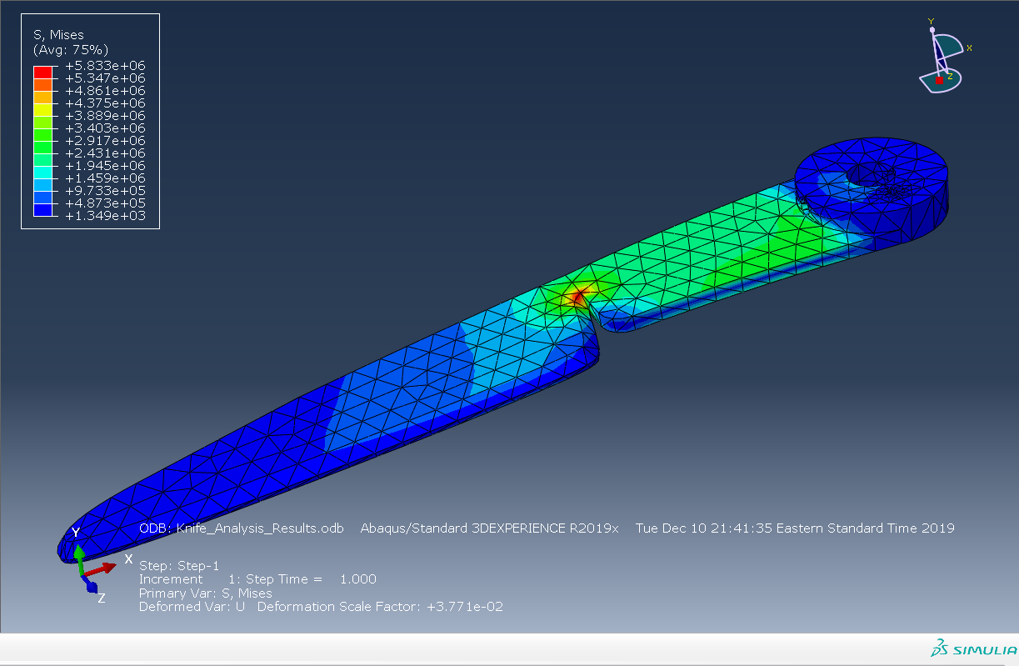
We can see high stresses at bridging points. Max stress on the bottle opener is 1.755E5 psi while max stress on the knife is 5.833E6 psi. For almost any type of steel we could use, this would result in yielding. For example, A36 steel with a thickness of less than 8 in has a minimum yield strength of 36,000 psi and an ultimate tensile strength of 58,000-80,000 psi. The upper bound for steel yield stress is 240,000 MPa or 348,090.6 psi. However, note that we were extremely conservative in our estimation of the use case-induced loads.

Slide 20
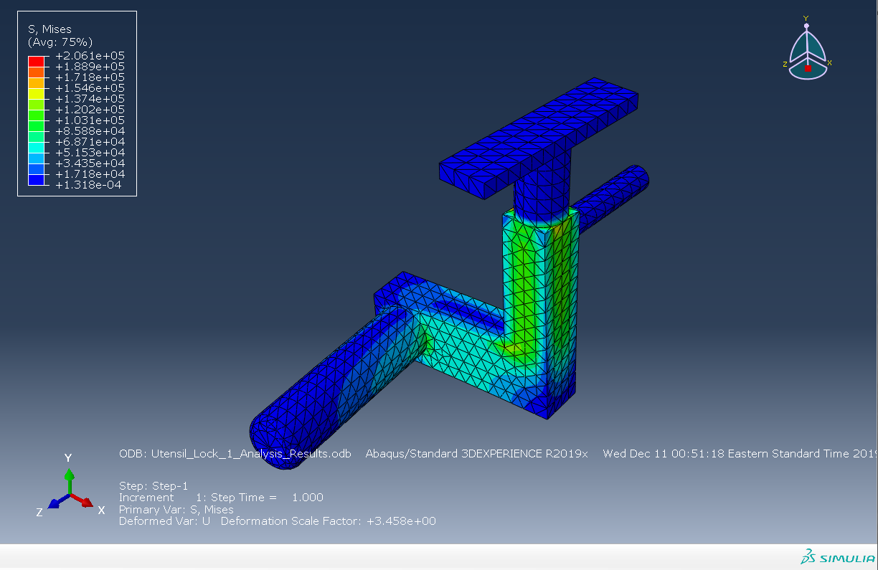
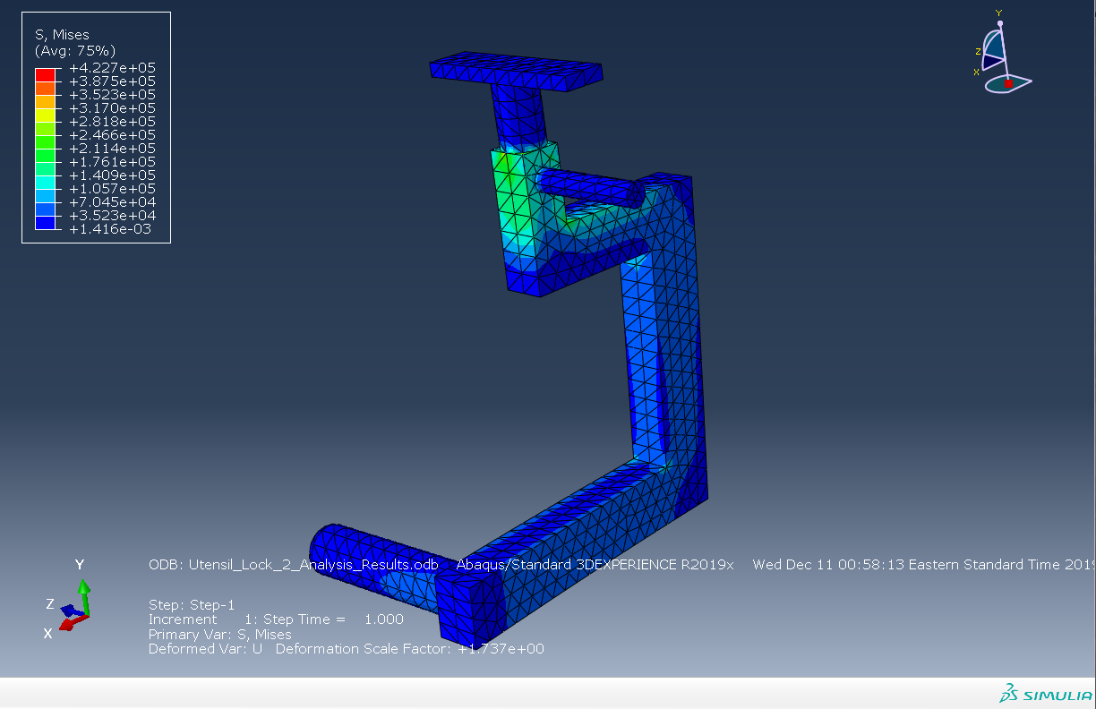
The release tabs also experienced high stresses from the torsional spring force. Max stress on the left one (Utensil Lock 1) is around 1.546E5 psi while max stress on the right one (Utensil Lock 2) is 2.466E5 psi.

Slide 21
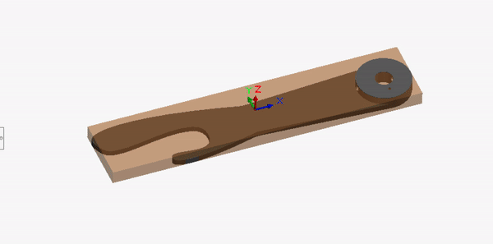
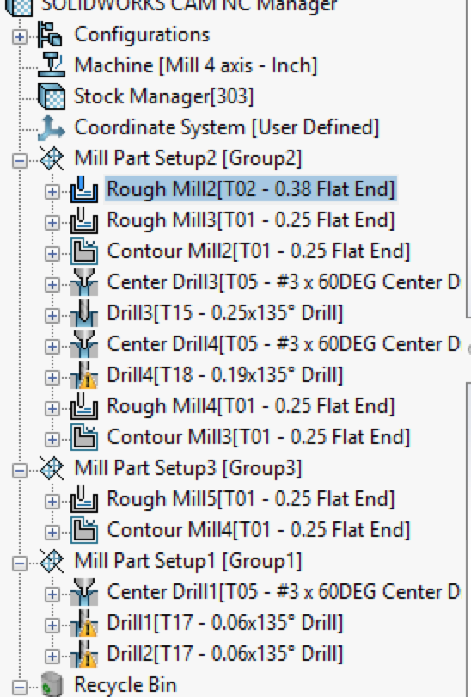
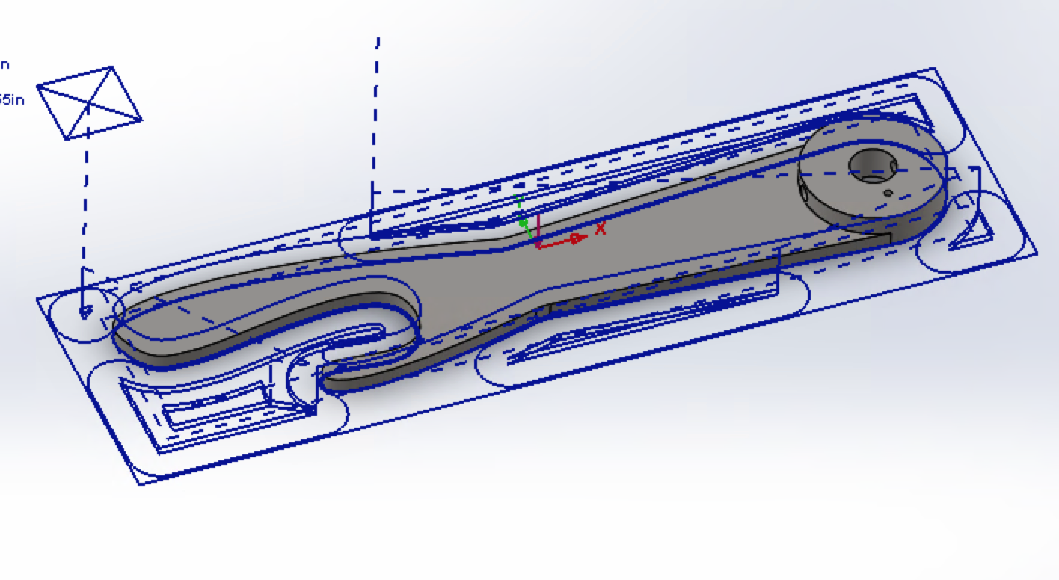
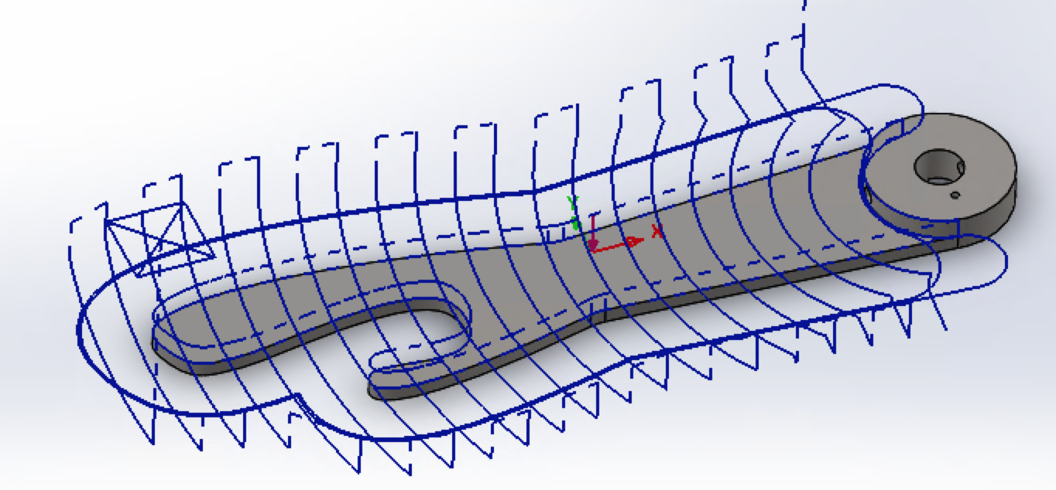
Computer Aided Manufacturing
1. Extract Machinable Features; 2. Generating Operation Plan; 3. Generate Toolpath; 4. Simulate Toolpath
Some alterations must be made to the machine as well as the bits that are available

Slide 22
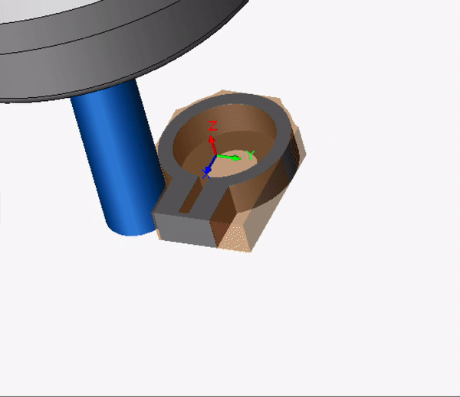
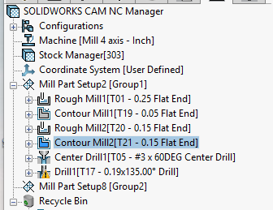
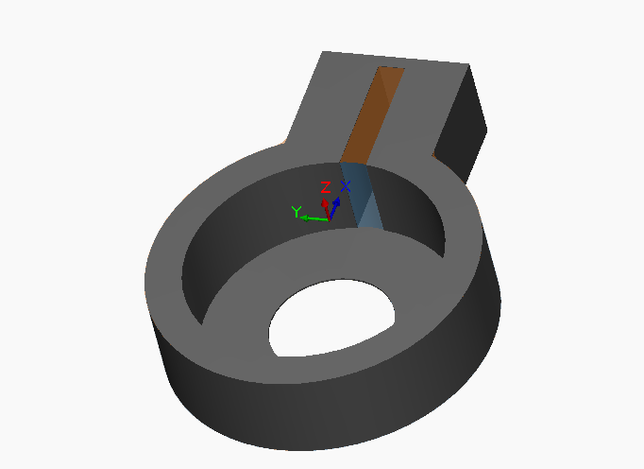
CAM Limitations
Some parts are not machinable
The small feature where the torsional spring would sit has a diameter too small for a milling bit to fit
90° angles are alson not machinable and can only be achieved with small radius bits
Notes:
I discovered that some of our designs were not machinable. For example the top rotation piece that holds the torsional sprin has a channel that is too small to be milled. There isn't a bit small enough to fit and remove the material
Another restraint is that machining 90 degree angles is difficult so I made the bit diameter smaller to remove more of the material and get an angle closer to 90 degrees.

Slide 23
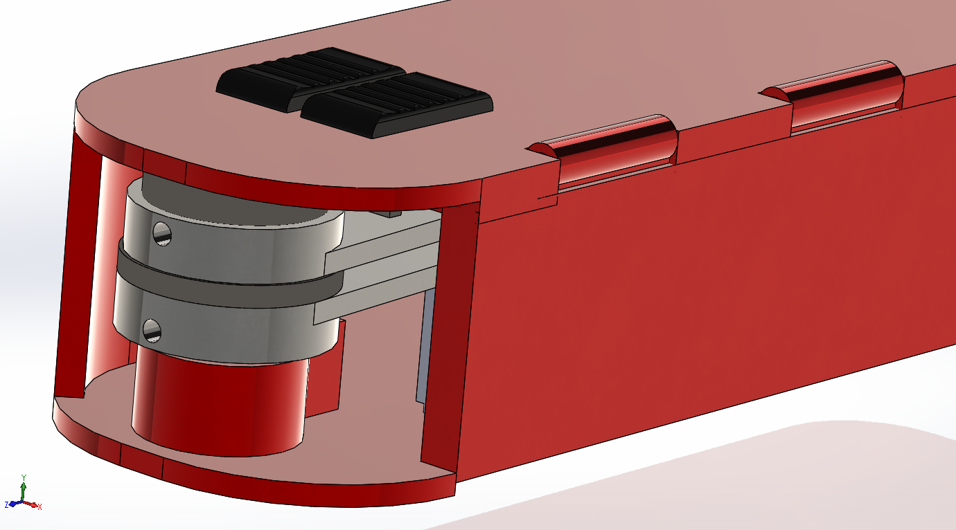
Tolerance Analysis: Tolerance Stack-Up
Case restricts the number of moving components at either end of the shaft- cumulative effect of the individual tolerances must be accounted for
Each moving component separately manufactured, so drawings used chain-dimensioning & tolerancing rather than baseline
TolAnalyst calculated the nominal, minimum and maximum values of these part thicknesses, as reflected in the engineering drawings

Slide 24


Tolerance Analysis: Engineering Fits
Engineering fits occur where two components interface and have to “fit” into each other
For example, the tolerances for a shaft and hole for a “press fit” must be specified such that the largest clearance allotted by the tolerances of the two features still makes it a snug connection
Different types of fits are standardized by ISO

Slide 25

Tolerance Analysis: Engineering Fits (cont.)
Every fit classified by its ISO standard, and assigned a symbol which corresponds to a unique tolerance (see figure)
The unique symbols for each fit are reflected in the engineering drawings

Slide 26

Tolerance Analysis: Remaining Dimensions
Remaining dimensions that do not have tolerance stack-up or engineering fit implications were assigned using tolerances published by the ISO standard tolerance grade chart
These dimensions were toleranced using IT16, which is described as for “”large manufacturing uses”
The tolerances were inserted using the symmetry standard (same upper and lower limits)

Slide 27

Assembly Drawings
All of the Assembly Drawings are separated within the Design Package folder
Sub-assemblies are listed in the main assembly drawing for each utensil holder
Assembly drawings include exploded views, as well as a reference side view

Slide 28

Part Drawings
All parts (excluding those downloaded from McMaster-Carr) have part drawings
Larger pieces, such as the casing, are depicted at a 1:1 scale
Smaller pieces, such as the door lock, are depicted at a 5:1 scale
Some features, such as splines, could not be referenced in the part drawings

